Slide 1
Our Model
Let's get Rolling!
Customer Segmentation
Analysis with Recency, Frequency, Monetary value (RFM)
Metrics
Probability of Customer Churn & Purchase forecast
Customer Equity
Identify Best customers based on Financial evaluation
Enhance Customer Experience & Value

Slide 2
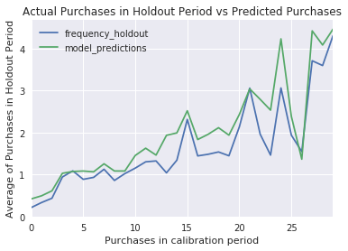
Model Insights
Getting into the finer details!
RFM Analysis
Heterogeneity metrics
Interval between purchases are used to calculate Transaction rate.
Ex: You can expect the transaction to be made by a customer on average is at a rate of 0.028 per day
Probability of customer churn out is 27.80% (Avg)
Customer Purchases:
Observed Vs Predicted
Model is capable of predicting repeated customer purchases greater than 5
Probability of Churn 50% if Recency hits 104 days
Customers on average visit 5 times : Frequency
Monetary value of purchases on average amounts to 77$

Slide 3
Model Insights
Getting into the finer details!
Customer Journey Insights
Keep your Product pricing close and Customers closer!
Customer who has low recency have low probability of Churn.
‘Engage with your customers constantly!’
Psst: We have a pricing model to help you out!
Track/Identify your Customer
Model can Identify your best Customer cohorts for two most important qualities.
Number of purchases
Value of the purchases
Calculate Equity value of your Customer base to assess profitability of the business
Personalized Recommender System
Enhance Customer equity by recommending Products to Customers with similar purchasing patterns.
Studied user preferences and product associations to build the model.

